Slide 1
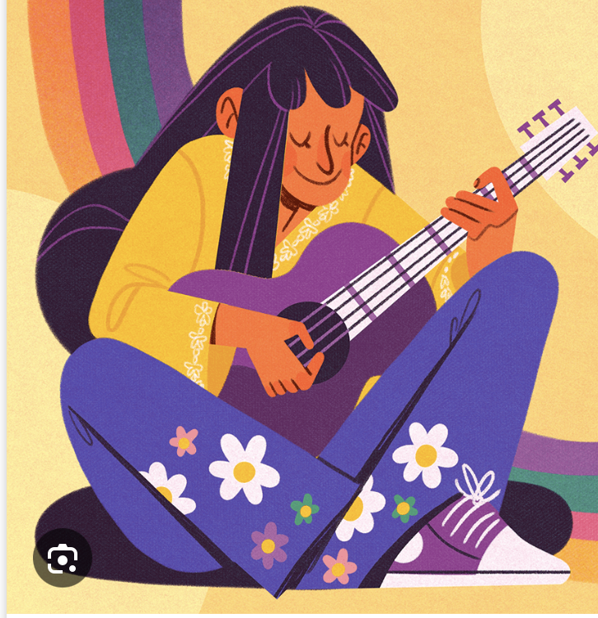
Music & Mental Health Survey Results
Does music help to reduce discorders?
Axèle and Jamyang
Notes:
Highlight:
Radar chart was hard.
Learning to do
TOP 3 ,
box plot,
size of the dashboard,
plus important de faire chart relevant than a beautiful chart.
As our data isn’t
Bins
Appliqué tous ce qu’on a appris dans la semaine.
Improuvement:
Trop de Bar chart.

Slide 2
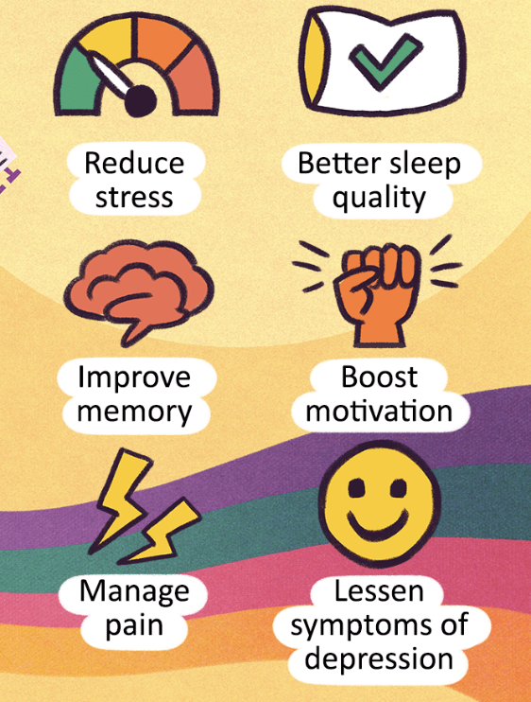
Impact of music :
Music has a significant impact on psychology, as mood regulation,
it can affect our emotional expression,
social bonding and can reduce stress.
Source: The effect of music listening on work performance
Lesiuk, T. (2005).

Slide 3
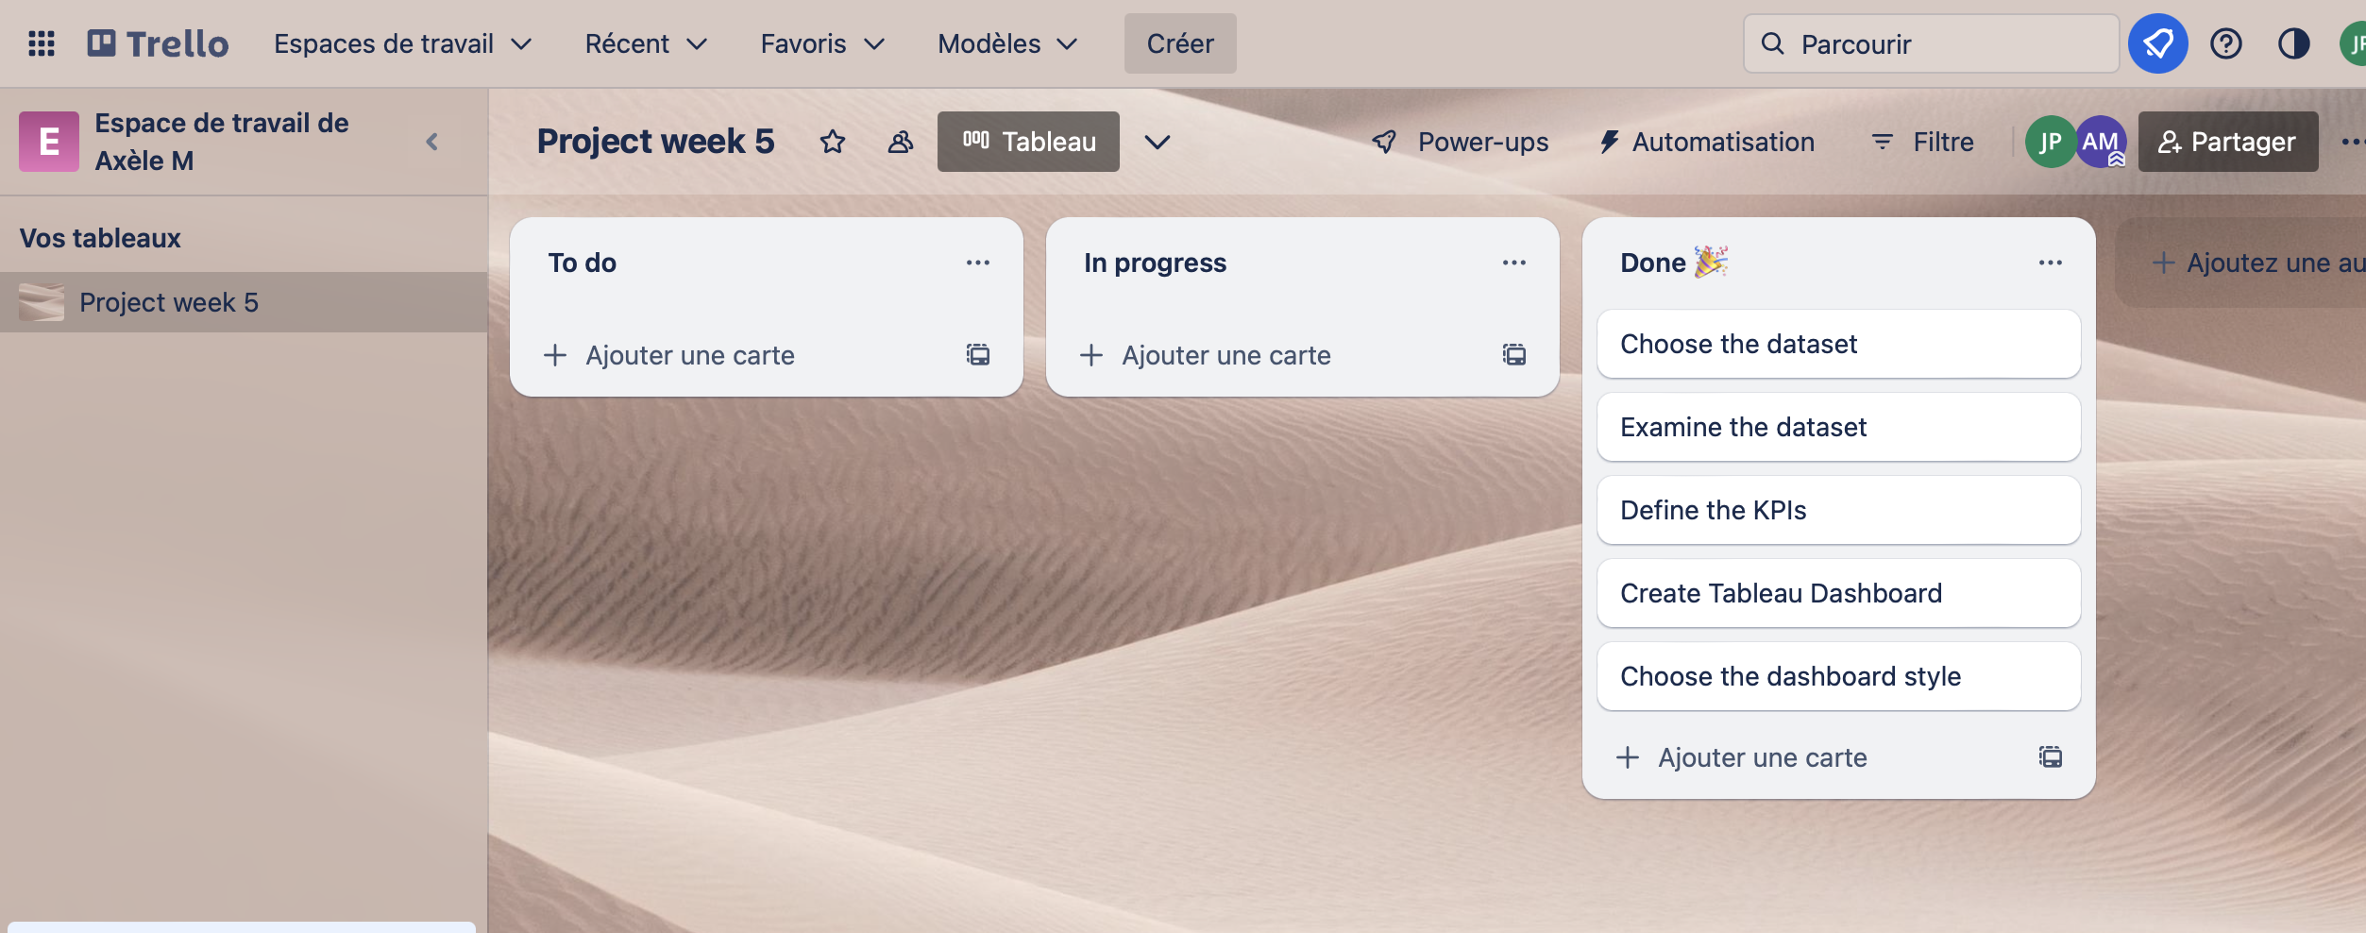
Process
Trello.

Slide 4
Our Dataset :
33 columns of 736 rows of suvey answered on 3 months.
2022 from August to October.

Slide 5
Learned:
Most important is to make a relevent chart than a beautiful chart :
By manipulating our dataset, our data are based from 3 month survey (ex: linechart)
TOP 3 to find « Which genre of music is most listened for each 4 disorder ? »
Size of the Dashboard : manage to ajuste to create a complete the dashboard?
« Hours per day at favorite genre. » Box plot
- Rock, Metal, Pop, classique.

